Slide 1
2022
Kent Test
Parent Workshop
10th June 2022

Slide 2
Overview
What is the Kent Test?
Papers
Examples of questions
Example timetable of the day
How can I register my child for the Kent Test?
Results and appeals
How can I support my child at home?
Kent admissions contact details

Slide 3
What is the Kent Test?
The Kent Test is an examination used to assess whether Year 7 grammar school entry is a suitable option for your child. It is used by most, but not all, of the selective and partially selective grammar schools in the region.
Taken at the beginning of September 2022
Focus on end of Year 6 and 7 learning objectives in maths

Slide 4
What is the Kent Test?
Many children will find the test difficult.
Grammar schools in Kent provide for children in about the top 25% of the ability range. In addition, some of Kent’s grammar schools - particularly those which are most likely to offer places to children from outside Kent - give priority to those with the highest scores. You may want to discuss your child’s academic achievement with their primary school before you decide whether to register them for the Kent Test.
Passing the Kent Test does not guarantee your child a place in a Kent grammar school.
Make sure you know where the Kent grammar schools are, and what the admissions criteria are for the school(s) you are interested in. You can search for Kent grammar schools with our Kent Schools search.

Slide 5
What is the Kent Test?
If your child has SEND
If your child has special educational needs or a disability that may affect the way they access the test, you need to discuss this with your current school's special educational needs coordinator (SENCO) in June 2022.
When you register your child for the Kent Test online, you will need to confirm if you have discussed a request for access arrangements with your child’s school.

Slide 6
Test Papers
The tests are multiple-choice with a separate answer sheet. They are marked by an automated marking machine.
The first test will be an English and maths paper and will take 1 hour. Each section will involve a 5 minute practice exercise followed by a 25 minute test. The English section will involve a comprehension exercise as well as some additional questions drawn from a set designed to test literacy skills.
The second test will be a reasoning paper. It will take about 1 hour, including the practice sections and questions. It will contain a verbal reasoning section and a non-verbal reasoning section of roughly the same length. The non-verbal reasoning will be split into short sections, administered and timed individually.
There will also be a writing exercise which will not be marked but may be used by a local headteacher panel as part of the headteacher assessment stage of the process. 40 minutes will be allowed for the writing task, including 10 minutes planning time.

Slide 7
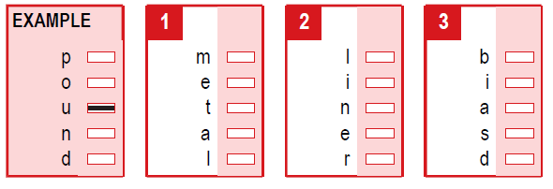
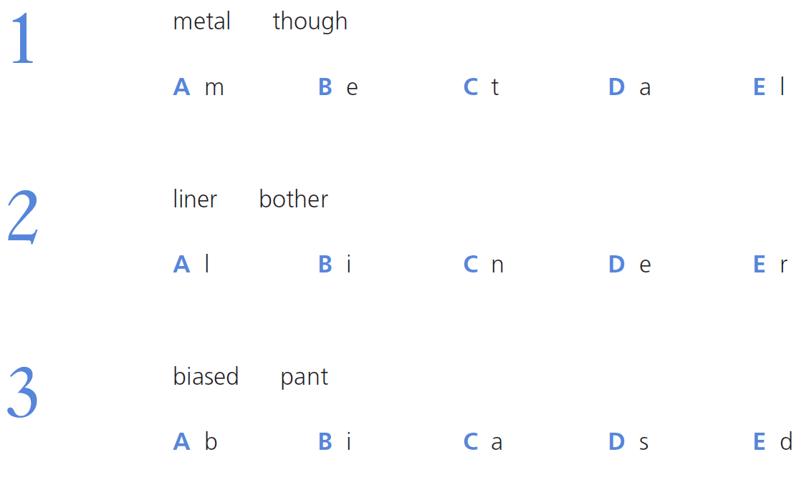
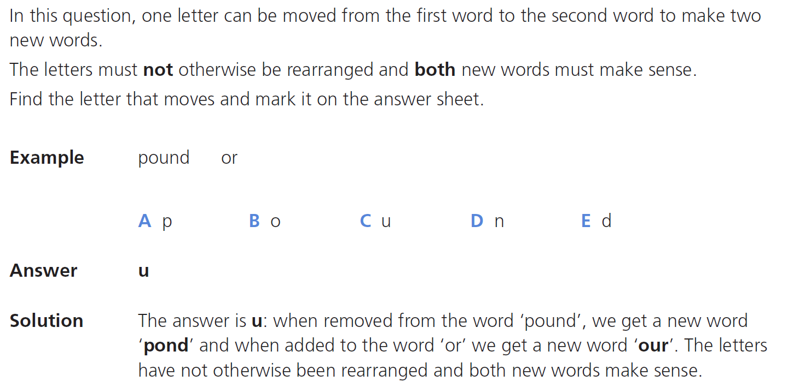
Examples of Questions - Verbal Reasoning

Slide 8
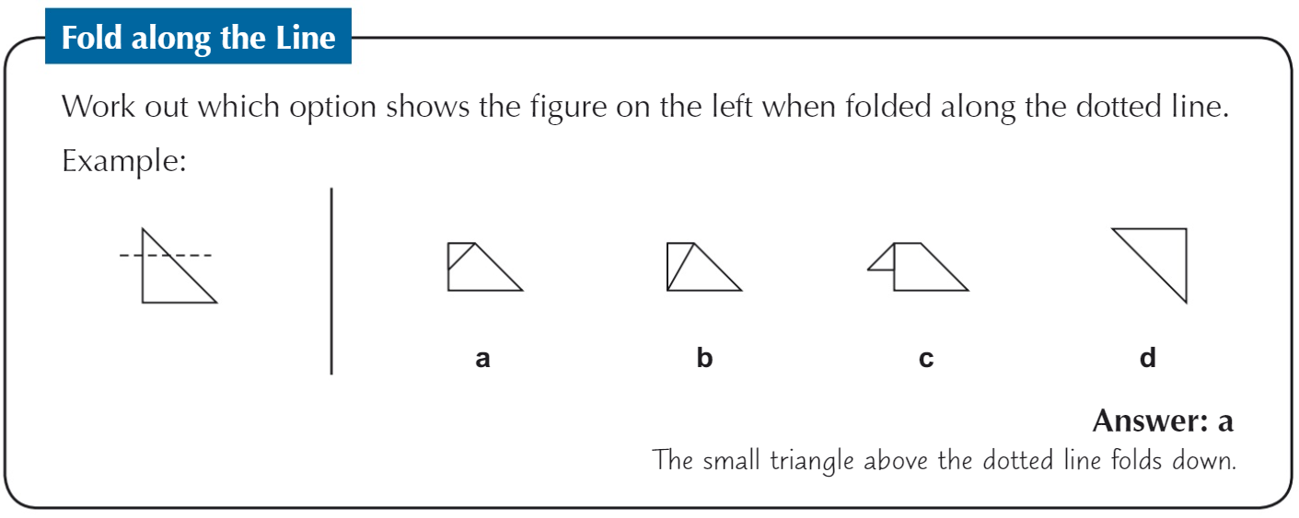
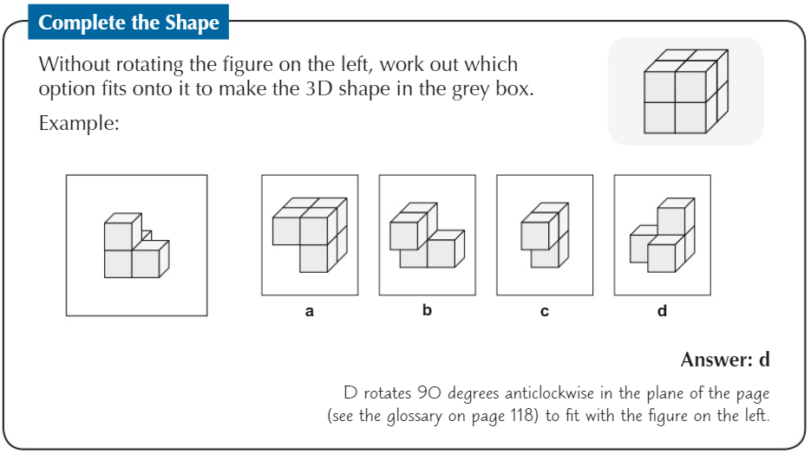
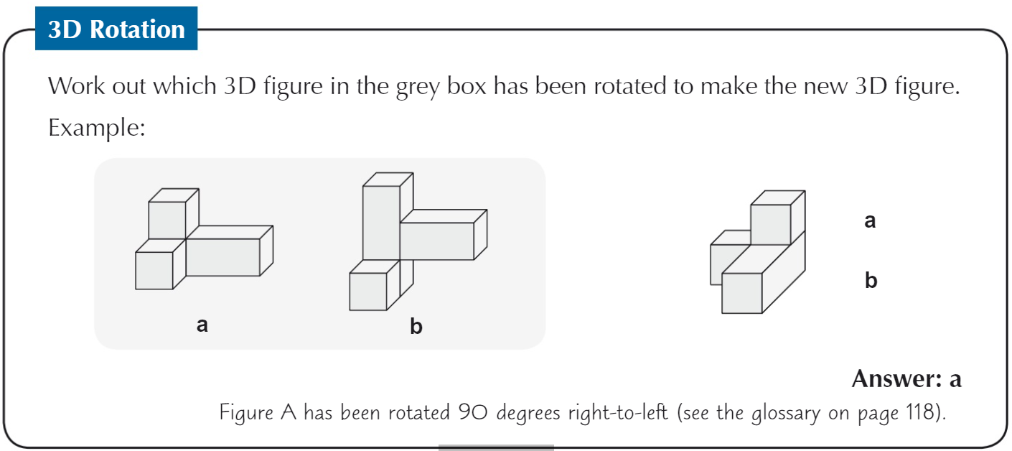
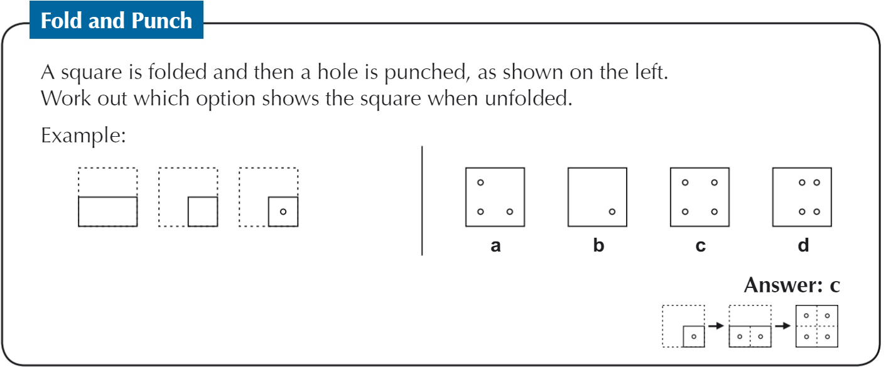
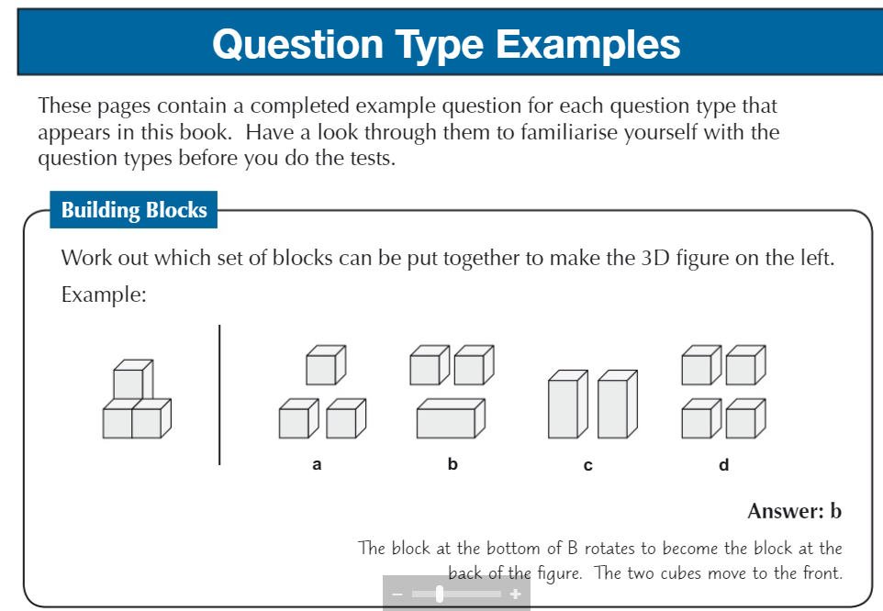
Examples of Questions - Non-Verbal Reasoning including (examples of spatial)

Slide 9
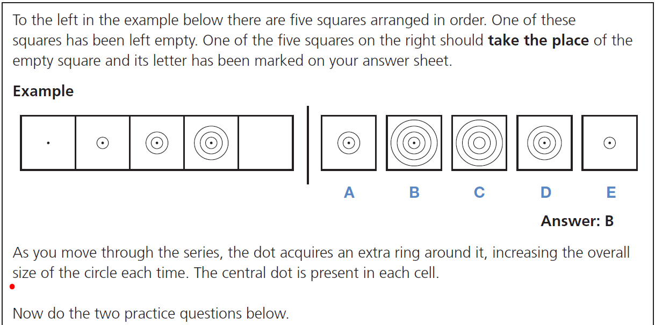
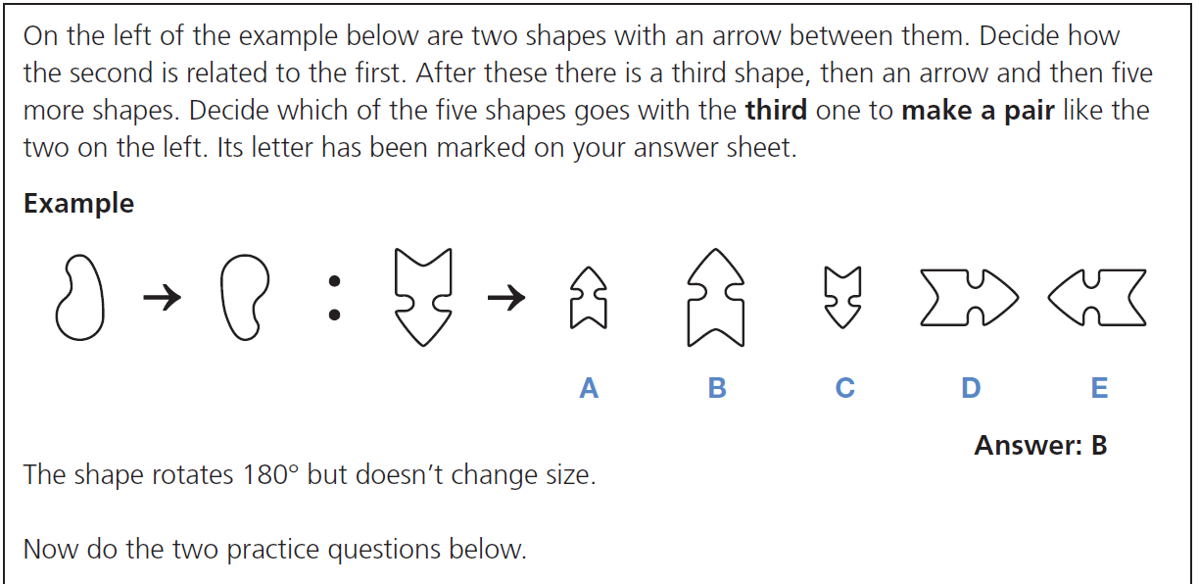
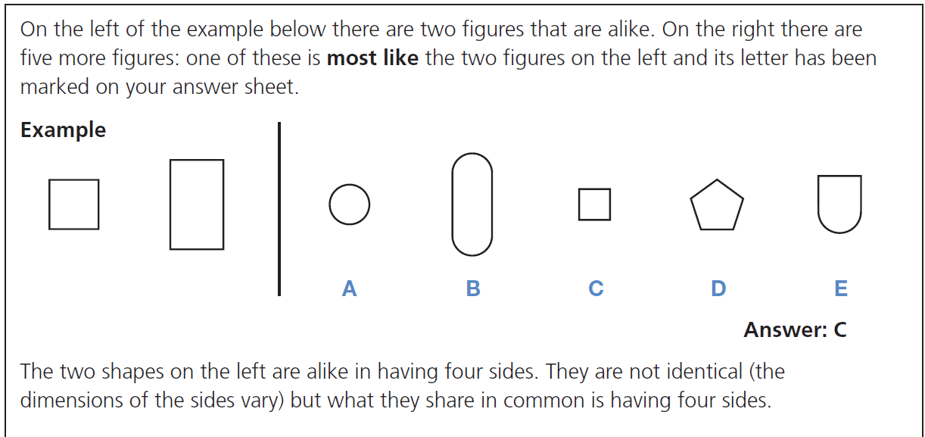
Examples of Questions - Non-Verbal Reasoning

Slide 10
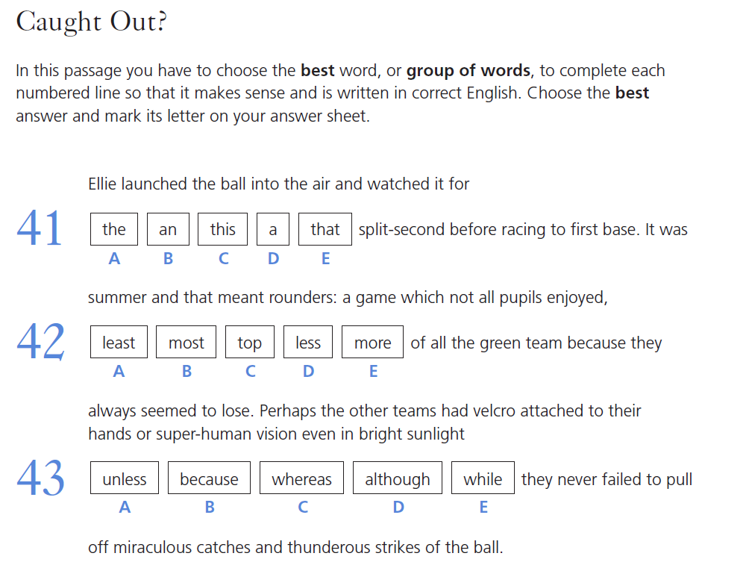
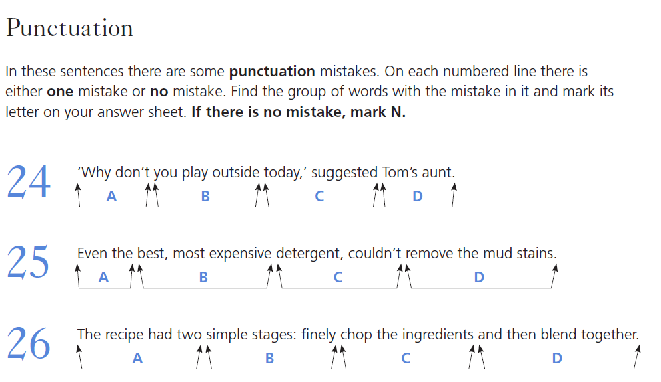
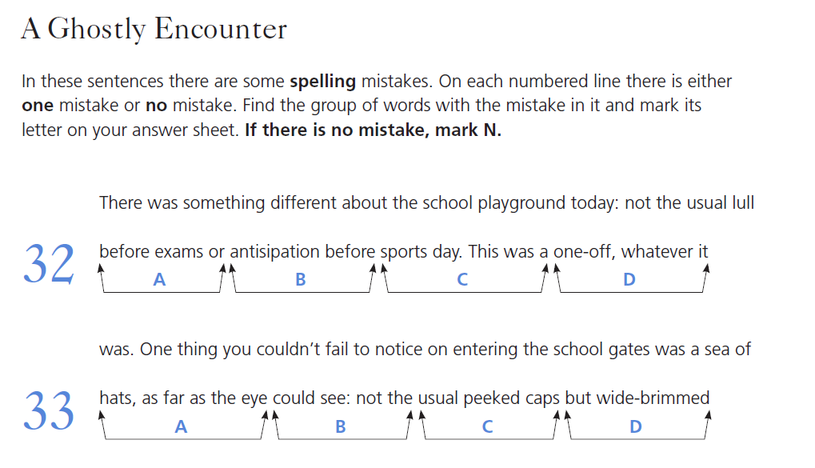
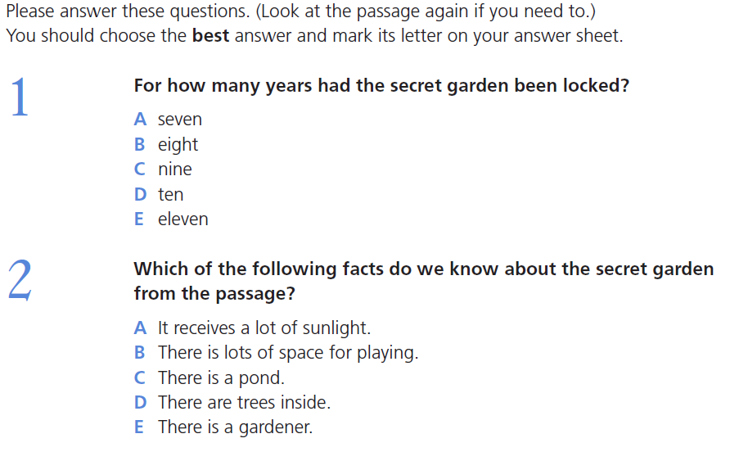
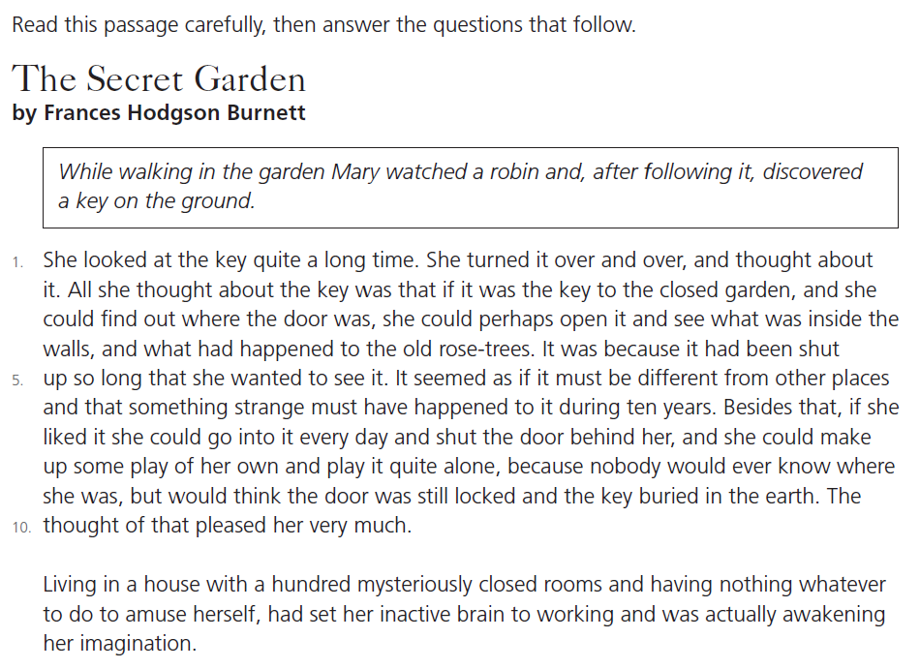
Examples of Questions - English

Slide 11
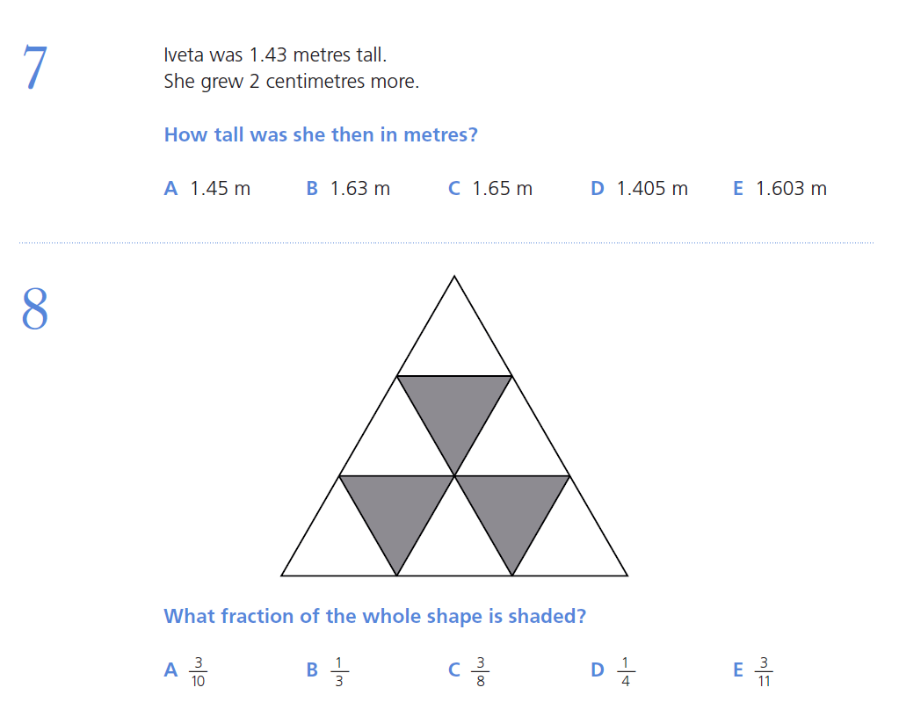
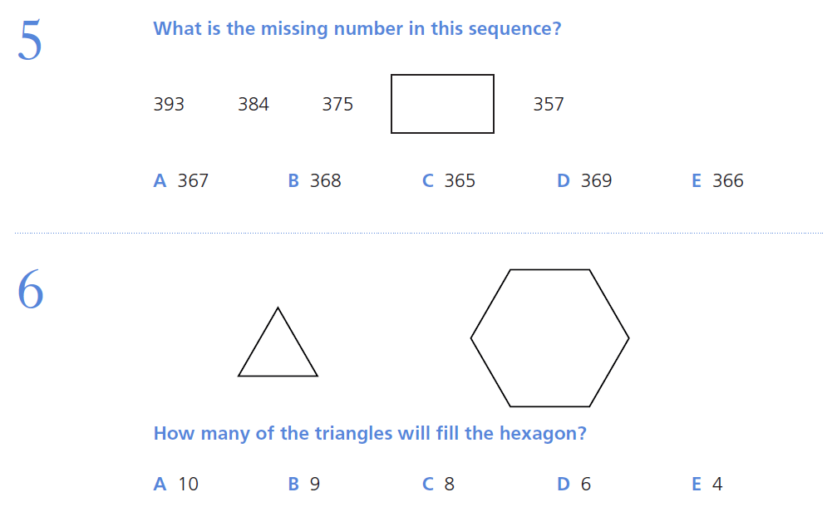
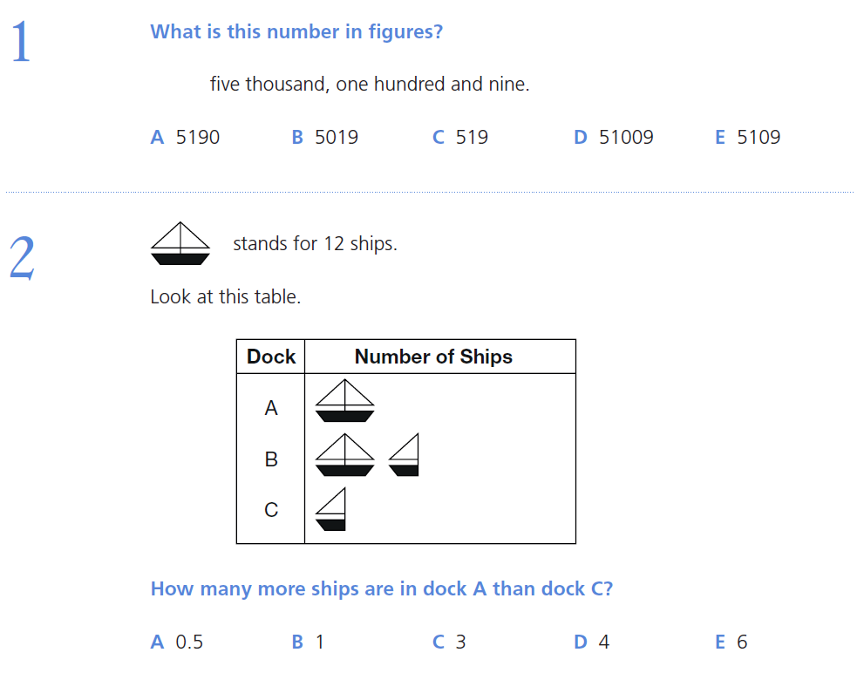
Examples of Questions - Maths

Slide 12
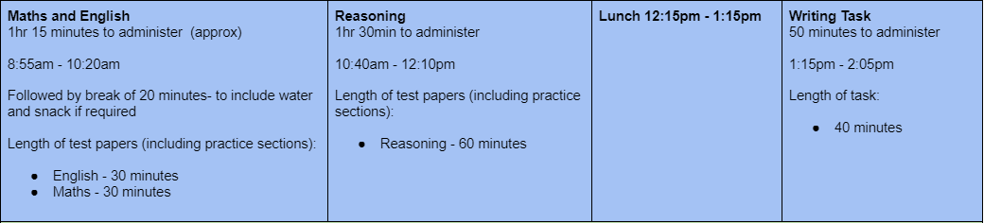
Example Timetable for the Day

Slide 13
How can I register my child for the Kent Test?
Registration usually opens on 1st June 2022 - 1st July 2022
You will need to make an account and register on this website - Kent Test
The Kent Test is only valid for Kent grammar schools. There are separate tests for Medway and Bexley.

Slide 14
Results and Appeals
Results will come out before you need to make your child’s secondary school choices (October usually).
Headteacher Appeals - These take place before results are shared with parents and carers. They are at the discretion of the headteacher based on pupil outcomes.
Parental Appeals - Take place after national offer day in March. Parents may then follow their chosen schools’ admission policy and submit an appeal directly to the school. You may only appeal to schools you have selected on your online form to Kent Admissions.
Grammar school threshold 2021
To be given a grammar school assessment , children needed a total score of 332 or more in the Kent Test, with no single score lower than 109. Test scores range from 69 to 141. The highest possible total score is 423.
If your child did not reach the threshold score and their primary school referred their case to the local Head Teacher Assessment Panel, the panel will have looked at their achievement in school and examples of their work, including the writing task completed on the day, before a final decision was made.

Slide 15
How can I support my child at home?
Kent-Test-familiarisation-booklet.pdf
Free Materials - GL 11+
Recommended reading lists
Useful websites
CGP books or ANY books that aline themselves to GL Assessment (company that writes the 11+ paper for Kent). Buy books in:
English
Maths
Verbal Reasoning
Non-Verbal Reasoning
Spatial Reasoning - THIS IS RELATIVELY NEW and there are not many books for this at this time

Slide 16
Kent Admissions Contact Details
kentonlineadmissions@kent.gov.uk

